Slide 1
MODULE-5 INTRODUCTION TO MECHATRONICS AND ROBOTICS

Slide 2

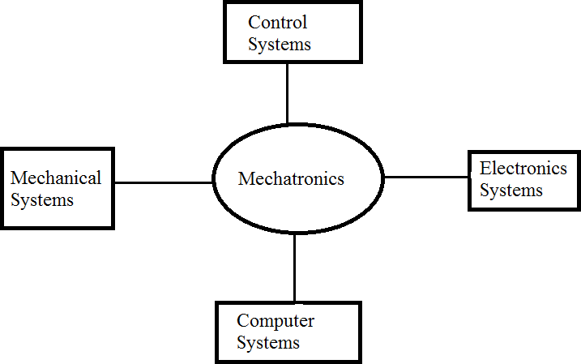
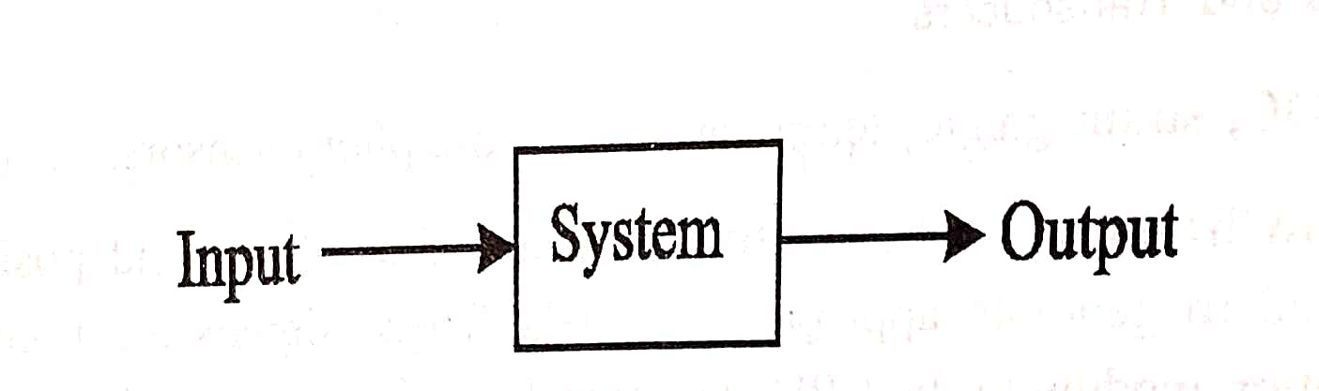
MECHATRONICS
Mechatronics is the integration of electronics with mechanical system for the precise control of the actuators of the mechanical system. Mechatronics systems mostly have
Microcomputers
Sensors
Control System
Mechanical System
Electronics System
SYSTEM
A system is one which has an input and an output. A system may be defined as an orderly combination or arrangement of elements, devices, components etc into the single unit to carry out certain well defined function
Department of Mechanical Engineering
www.cambridge.edu.in

Slide 3
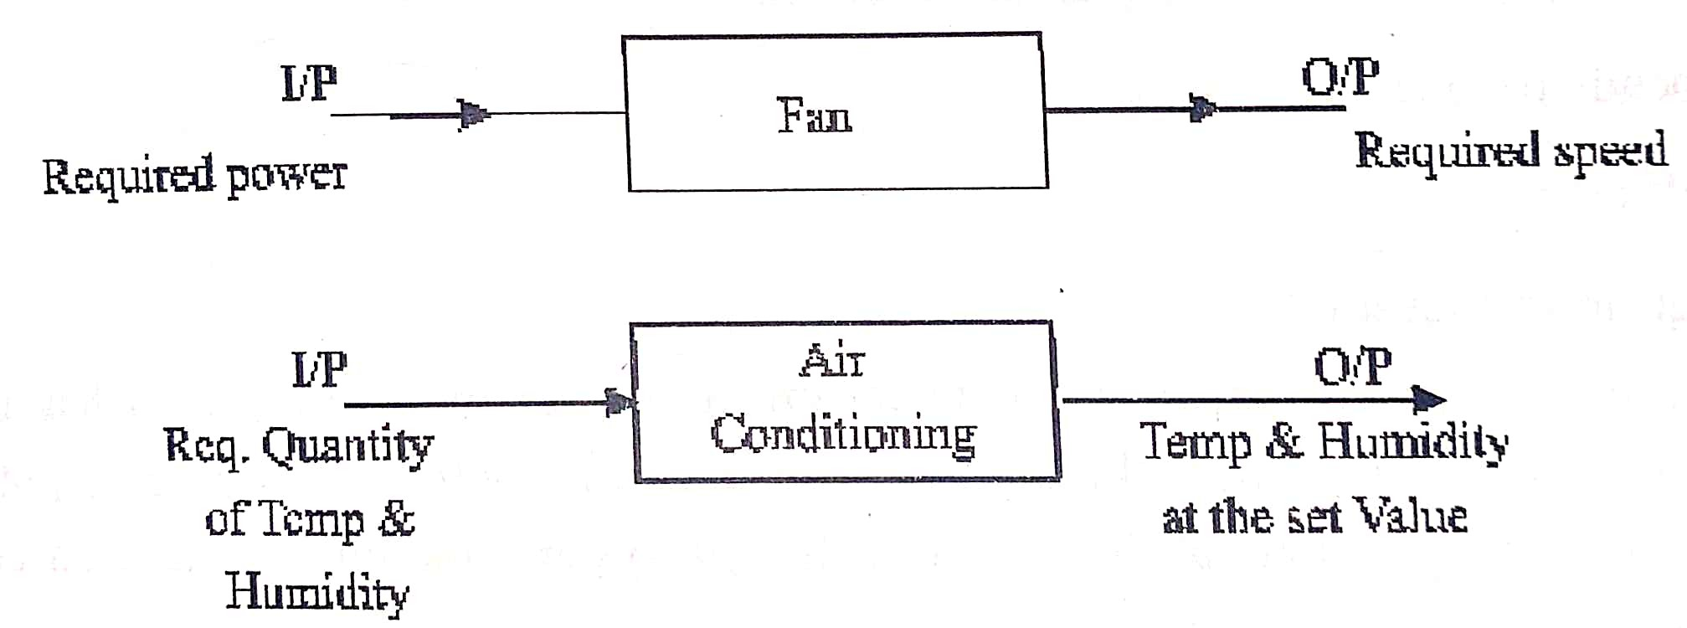
CONTROL SYSTEM
This is used to control its output to some particular value or particular sequence of values
Ex: Temperature Control Unit, Speed Control Unit, Sound Controller Unit etc
A group of devices which maintain the required output based on the quantity by controlling the parameters responsible for the output constitutes a control system
Department of Mechanical Engineering
www.cambridge.edu.in

Slide 4
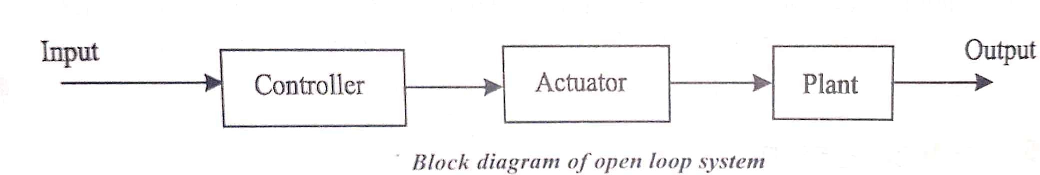
CLASSIFICATION OF CONTROL SYSTEM
Control Systems are broadly classified into two types
Open-loop control system
Closed-loop control system (Feed back control system)
1. OPEN-LOOP CONTROL SYSTEM
A Control system in which the output is dependent on input but input is independent of output is called an ‘Open-loop Control System’
On-off of an electric lamp
Controlling the temperature of the room with a room heater
Department of Mechanical Engineering
www.cambridge.edu.in

Slide 5
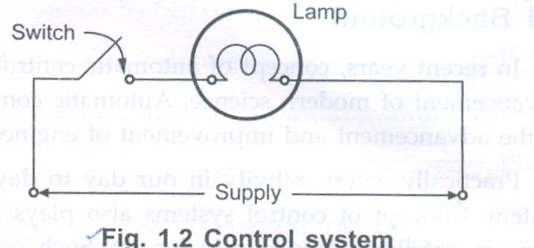
ON-OFF OF AN ELECTRIC LAMP
Electric Lamps are used for lighting an area
ON-OFF control is carried out with the help of a switch and the switch is operated by a human being depending on the amount of light that exists in that area
If the switch is ON, the light bulb will glow
If the person operating the switch does not put OFF the switch, the light remains glowing immaterial of weather there is enough natural light or not in that area
Similarly the light remains OFF, if it is kept switched OFF, in the absence of the operator, immaterial of weather there is enough light in that area or not
In the above example the ON or OFF of the switch depends completely on the human observation and not on the amount of light in that area where the light bulb is provided
Department of Mechanical Engineering
www.cambridge.edu.in

Slide 6
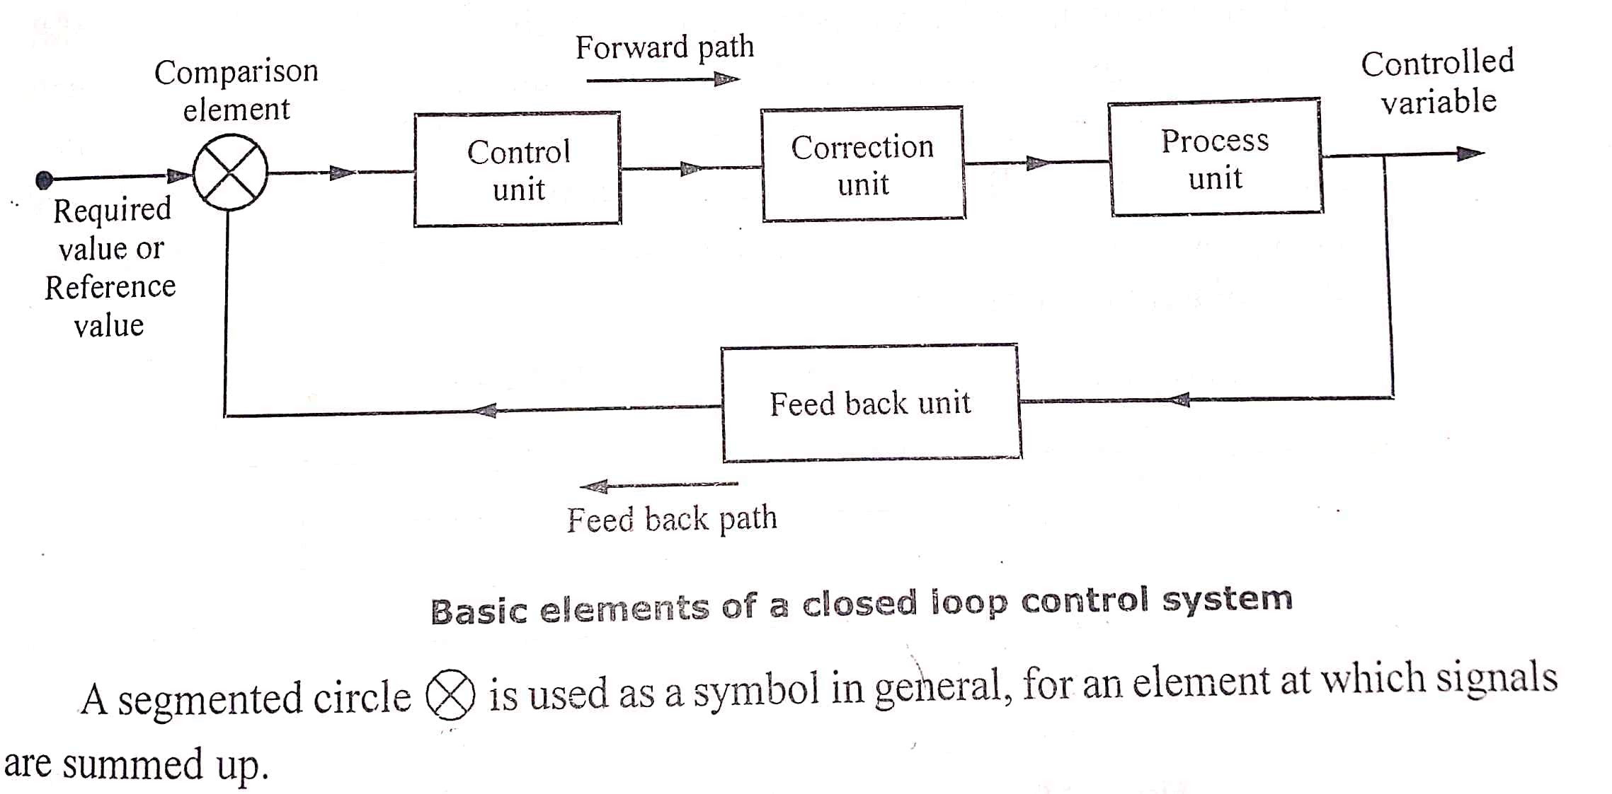
2. CLOSED-LOOP CONTROL SYSTEM
A control system in which the input is dependent on the output, i.e. Variation in the output influences the input by some means of controlling on the input is called closed loop control system
A closed loop control system consists of a feedback unit
Feedback unit compares the reference input with the output of the system
The difference between the actual value of the variable with the desired value of that variable is called Error
Department of Mechanical Engineering
www.cambridge.edu.in

Slide 7
Comparison Element:- This unit compares the reference or set value with that of the measured value or feedback signal and produces an error signal. Error Signal = [Reference Value – Measured Value]
Control Unit:- Control unit analyses the error signal and decides what action is to be initiated and takes the necessary action. Then this unit produces a signal, which may be to operate a switch or a valve or perhaps a signal to open or close a valve
Correction Unit:- The modified signal from the control unit will be received by the correction unit which produces a change in the process to correct or change the controlled condition
Process Unit:- It is the one which is being controlled. It could be the speed of a motor, speed of a vehicle, air conditioner
Examples of closed-loop control system are
1. Hand reaching an object 2. Speed control of an automobile 3. Water level control of overhead tanks
4. Automatic piloting of aircrafts 5. Room temperature controller 6. Temperature control in a refrigerator
Department of Mechanical Engineering
www.cambridge.edu.in

Slide 8
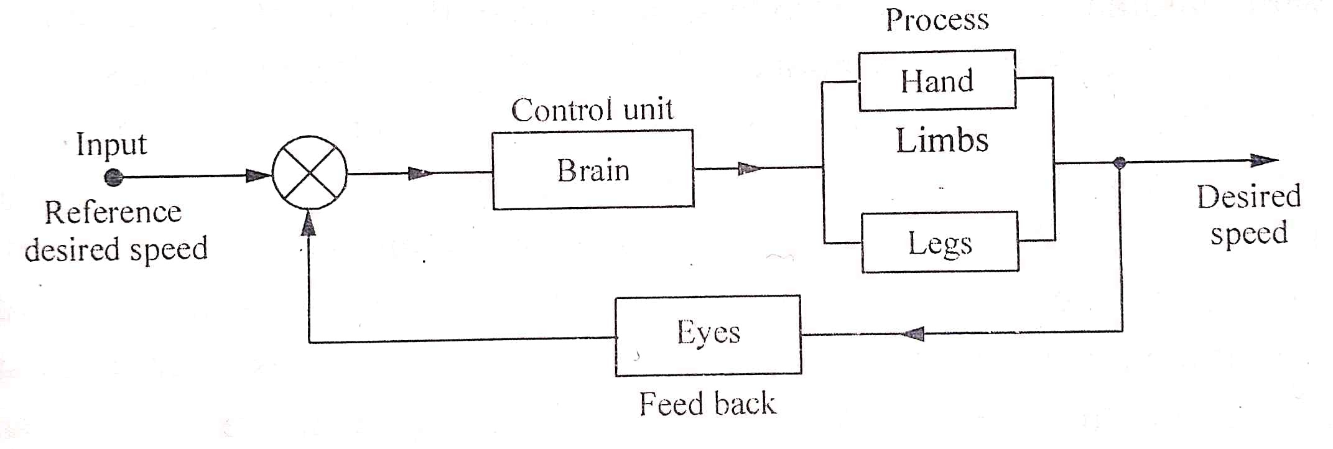
SPEED CONTROL OF AN AUTOMOBILE
The driver observes the speedometer and based on the speed shown by the speedometer he decides whether the accelerator should be increased or decreased or gear change is to be made
Memory of the person stores the speed at which the vehicle is to be driven. The speed shown on the speedometer is feedback
Feedback signals from the eyes compares the desired speed in the memory of the driver, error signals are given to brain
Brain manipulates the error and gives signals to the hands and legs. The hand changes the gear and in the process applies the clutch from the leg and increases the fuel supply if the speed is less than the desired speed, otherwise decreases the fuel supply
Department of Mechanical Engineering
www.cambridge.edu.in

Slide 9
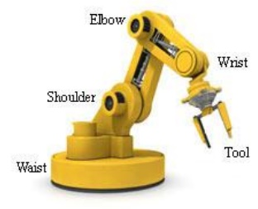
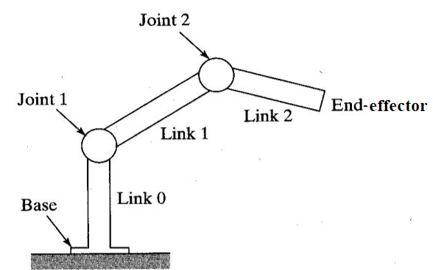
INTRODUCTION TO ROBOTICS
Definition: An industrial robot is a programmable, multi-functional manipulator designed to move materials, parts, tools, or special devices through variable programmed motions for the performance of a variety of tasks
ROBOT ANATOMY:
The anatomy of industrial robots deals with the assembling of outer components of a robot such as waist, shoulder, elbow, wrist and end effector.
Link 0: The robotic base and its connection to the joint 1 is called as link-0. Link-0 is the input link for joint-1, while the output link from joint-1 is link-1 which leads to joint-2
Link 1: is the output link for joint-1 and the input link for joint-2. This joint-link-numbering scheme is further followed for all joints and links in the robotic systems.

Slide 10

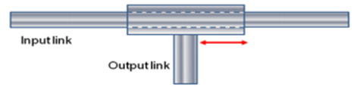


TYPES OF JOINTS:
Sl No | Name | Description | Diagram
1 | Linear Joint | The relative movement between the input link and the output link is a translational sliding motion, with the axes of the two links being parallel
2 | Orthogonal Joint | This also has a translational sliding motion, but the input and output links are perpendicular to each other during the move.
3 | Rotational Joint | This type provides relative rotational motion, with the axis of rotation perpendicular to the axes of the input and output links.
4 | Twisted Link | This joint also involves rotary motion, but the axis or rotation is parallel to the axes of the two links.

Slide 11
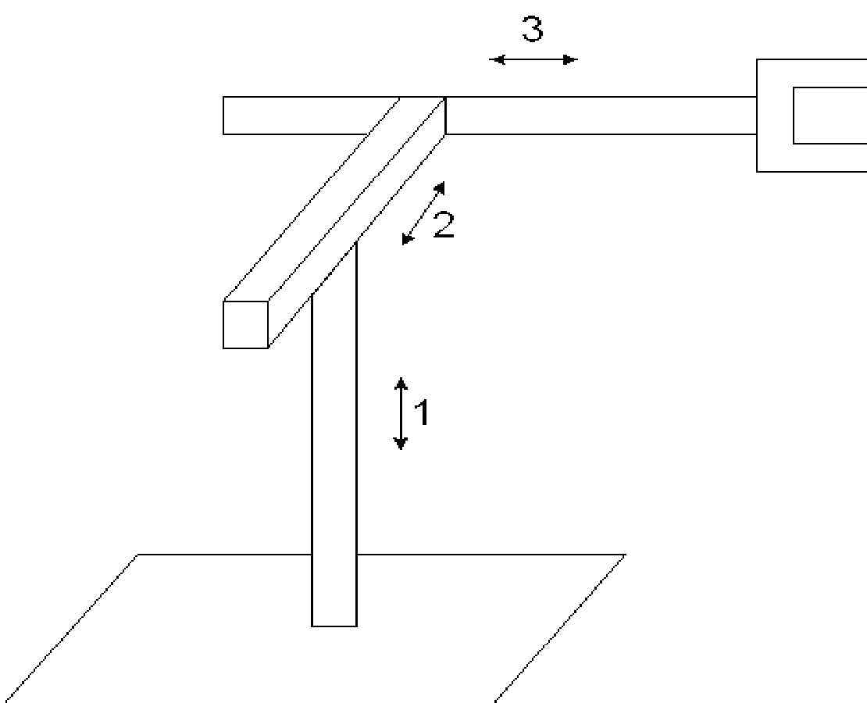
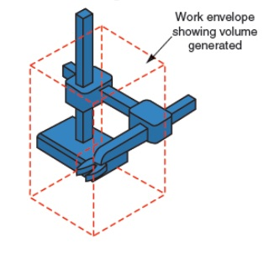
CARTESIAN COORDINATE CONFIGURATION
The robots will process in a rectangular work space by means of this three linear movement. It is capable of carrying high payloads with the help of its rigid structure.
Advantages:
Highly accurate & speed,
Fewer cost
Simple operating procedures, and
Disadvantages:
Less work envelope, and
Reduced flexibility
Applications:
Pick and place work
Assembly operations
Handling machine tools
Arc welding
Figure: Cartesian Coordinate Geometry

Slide 12
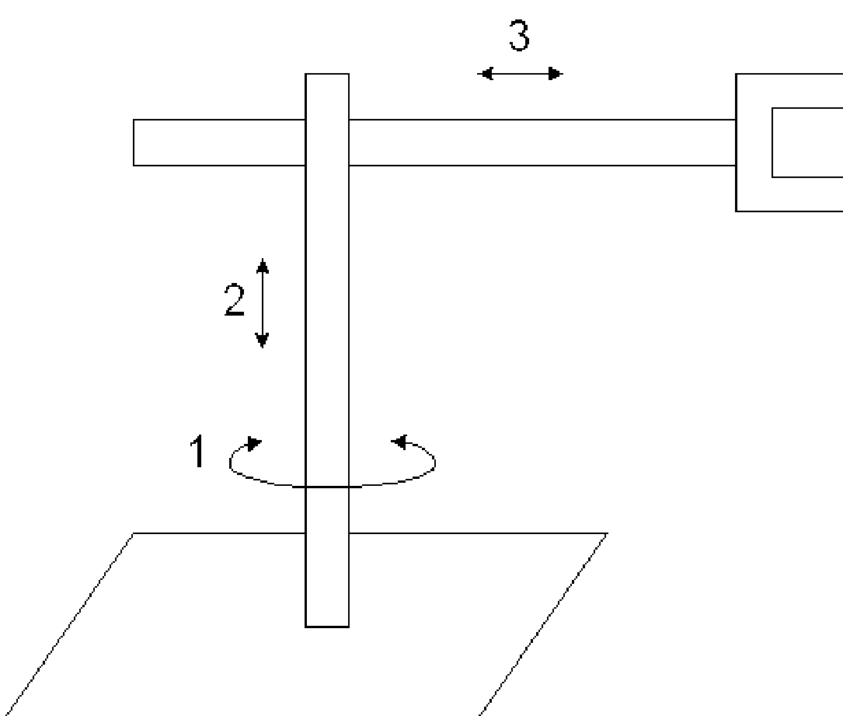
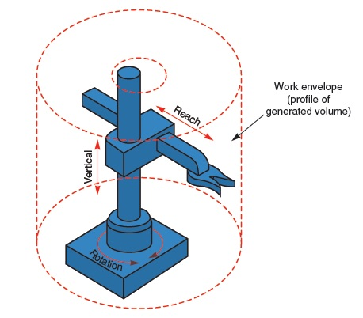
POLAR CYLINDRICAL CONFIGURATION
The robots will process in a cylindrical work space by means of this one rotary and two linear movements. Here, the slide is capable of moving in up & down motion with the help of the column.
Advantages:
Increased rigidity, and
Capacity of carrying high payloads.
Disadvantages:
Floor space required is more, and
Less work volume
Applications:
Handling at die-casting machines
Assembly operations
Handling machine tools
Spot welding
Figure: Cylindrical Coordinate Geometry

Slide 13
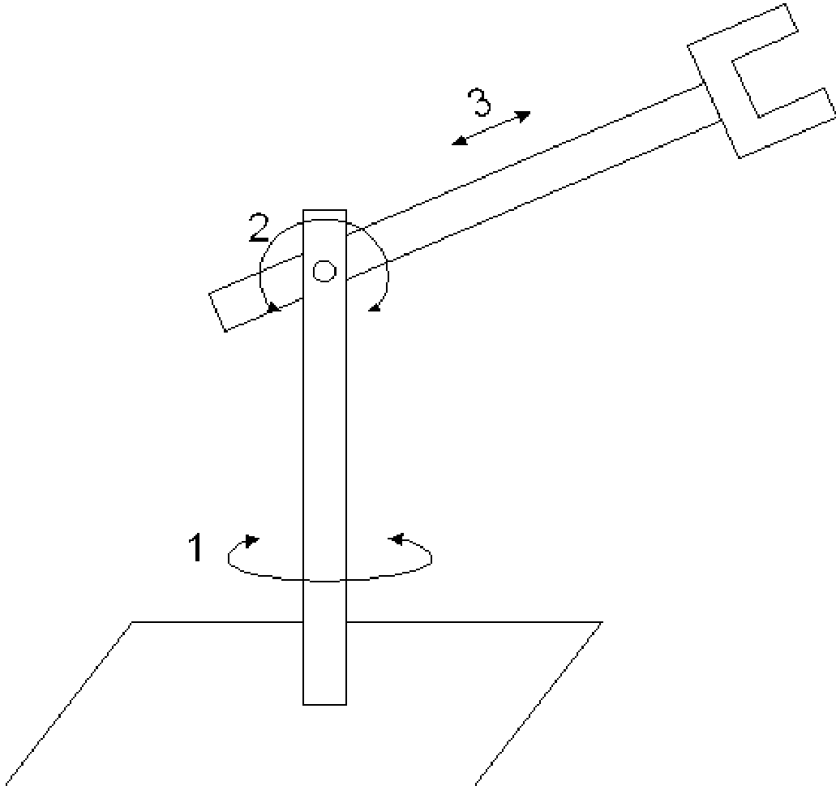
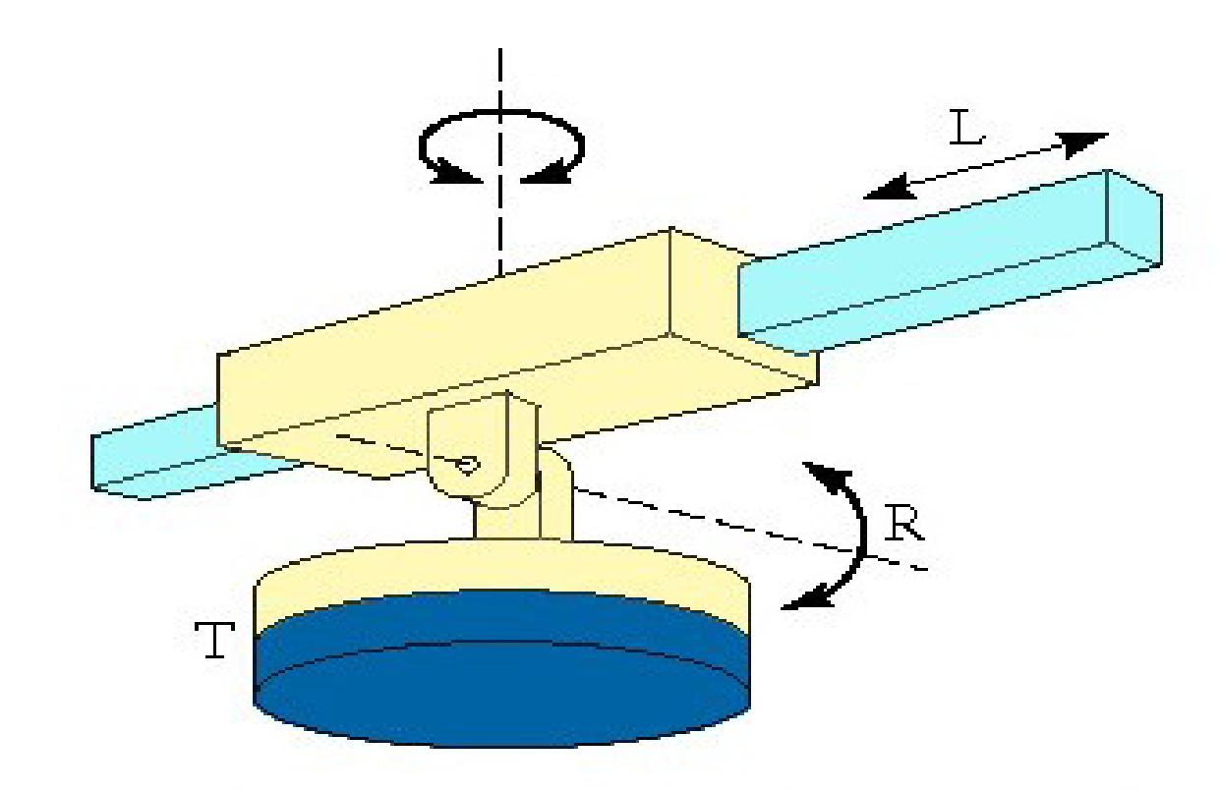
SPHERICAL CONFIGURATION
The robots will process in a cylindrical work space by means of this two rotary and one linear movements. Here, the slide is capable of moving in up & down motion with the help of the column.
Advantages:
Long reach capability in the horizontal position.
Disadvantages:
Vertical reach is low
Applications:
Handling at die casting
Handling machine tools
Arc/Spot welding
Figure: Spherical Coordinate Geometry

Slide 14
AUTOMATION IN INDUSTRY
Automation means: Auto = Self & mation = motion
Self + Motion = Automation. Automation solutions are required right from Agriculture to Space Technology. Automation is the necessity for manufacturing industry to survive in today's globally competitive market.
Definition:
Automation is a set of technologies that results in operation of machines and systems without using significant human intervention and achieves performance superior to manual operation.
Need of Automation:
1. Improved quality & accuracy 2. Increased productivity 3. Greater product variety
4. Complete gain control of manufacturing process 5. Consistency in manufacturing
6. Working in difficult & hazardous environment 7. Quick change over from one product to another 8. Reduced cost of quality

Slide 15
TYPES OF AUTOMATION
Fixed Automation System:
It is used in high volume production with dedicated equipment, which has a fixed set of operation and designed to be efficient for this set. Continuous flow and Discrete Mass Production systems use this automation. e.g. Distillation Process, Conveyors, Paint Shops, Transfer lines etc. A process using mechanized machinery to perform fixed and repetitive operations in order to produce a high volume of similar parts.
Advantages:
High levels of production
Consistent quality in production
Low cost per unit produced
Disadvantages:
High initial cost
Difficult to accommodate changes
This type of automation is best suited for:
High demand and generic products that require no change.

Slide 16
TYPES OF AUTOMATION
2. Programmable Automation System:
It is used for a changeable sequence of operation and configuration of the machines using electronic controls. However, non-trivial programming effort may be needed to reprogram the machine or sequence of operations. Investment on programmable equipment is less, as production process is not changed frequently. It is typically used in Batch process where job variety is low and product volume is medium to high, and sometimes in mass production also. e.g. in Steel Rolling Mills, Paper Mills etc.
Advantages:
Flexibility to change products if needed
Suitable if batch production is required
Disadvantages:
Expensive for equipment
Lower production levels
Often time-consuming to change products
This type of automation is well suited for:
Low/Medium demand and occasional changes in products.

Slide 17
TYPES OF AUTOMATION
3. Flexible Automation System:
It is used in Flexible Manufacturing Systems (FMS) which is invariably computer controlled. Human operators give high-level commands in the form of codes entered into computer identifying product and its location in the sequence and the lower level changes are done automatically. Each production machine receives settings/instructions from computer. These automatically loads/unloads required tools and carries out their processing instructions. After processing, products are automatically transferred to next machine.
Advantages:
Flexibility of products
No time lost with new changes to production
Disadvantages:
High custom machinery/automation cost
Higher cost per unit
This type of automation is best suited for:
Medium demand and constant changes/large variety in products.

Slide 18
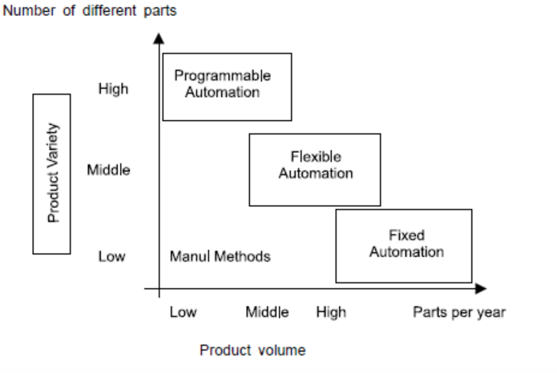

Slide 19
INTERNET OF THINGS (IOT)
The Internet of Things (IoT) describes the network of physical objects—“things”—that are embedded with sensors, software, and other technologies for the purpose of connecting and exchanging data with other devices and systems over the internet.
This technology allows for the collection and sharing of data from a vast network of devices, creating opportunities for more efficient and automated systems. The IoT devices include wireless sensors, software, actuators, computer devices.
All complete IoT systems are the same in that they represent the integration of four distinct components: sensors/devices, connectivity, data processing, and a user interface.
Examples: smart mobiles, smart refrigerators, smart watches, smart fire alarms, smart door locks, smart bicycles, medical sensors, fitness trackers, smart security system.
Applications of IoT:
1) Home 2) Cities 3) Environment 4) Energy 5) Retail 6) Logistics 7) Agriculture 8) Health & Life Style

Slide 20
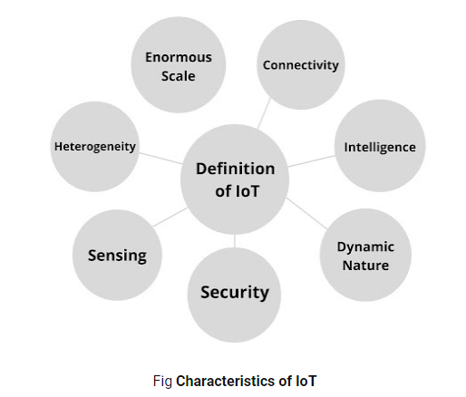
CHARACTERISTICS:
1) Dynamic and Self-Adapting:- IoT devices and system have the capability to change dynamically depending upon the system and operating conditions or sensed environment.
For example, the surveillance cameras can change their modes based on day or night, sleeping and waking up
2) Self-configuring:- IoT devices have self-configuring capability which allows large number of devices to work together to provide certain functionality they can change their networking and update the software automatically.
3) Interoperable Communication Protocol: - IoT devices can communicate with number of interoperable communication protocols.
Unique ID: - IoT devices have a unique identity differentiated with unique IP address.

Slide 21
4) Integrated into Information Network: - IoT devices are integrated into the information network that allows them to communicate and exchange data with other devices and system.
5) Enormous scale: The number of devices that need to be managed and that communicate with each other will be at least an order of magnitude larger than the devices connected to the current Internet.
6) Safety: This includes the safety of our personal data and the safety of our physical well-being. Securing the endpoints, the networks, and the data moving across all of it means creating a security paradigm that will scale.
7) Interconnectivity: With regard to the IoT, anything can be interconnected with the global information and communication infrastructure.

Slide 22
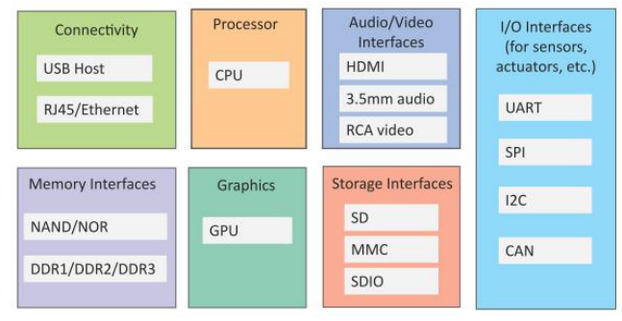
PHYSICAL DESIGN OF IOT
A physical design of an IoT system refers to the individual node devices and their protocols that are utilised to create a functional IoT ecosystem.
These devices can exchange and communicate with each other. Each node device can perform tasks such as remote sensing, actuating, monitoring, etc., by relying on physically connected devices. It is also capable of transmitting information through different types of wireless or wired connections.
1. I/O interfaces for sensors (Building connections)
2. Interfaces for internet connectivity (Providing graphical interfaces)
3. Memory and storage (Providing storage)
4. Audio and video interface (Providing graphical interfaces)

Slide 23
IOT PROTOCOLS
It is a set of rules that need to be followed by the communicating parties in order to have successful and reliable data communication. For example - Ethernet and HTTP.
Protocols
1. IEEE 802.3--Ethernet (wired connection)
2. 802.11 –Wi-Fi
3. 802.16—WiMax
4. 2G/3G/4G/5G—Mobile communication
Network/Internet Layer The network layers are responsible for sending of IP datagram’s from the source network to the destination network. It performs host addressing and packet routing. The datagram’s consists of source and destination addresses where host identifies using IP schemes as IPV4 and IPV6.
Protocols :
IPV4:- It is used to identify the devices on a network using hierarchical addressing scheme. It uses 32- bit address that allows total 2^32 or 4 billion devices 128
IPV6:- It is the new version of internet protocol which uses 128-bits address that allows 2^128 or 3 X 10^38 address.

Slide 24
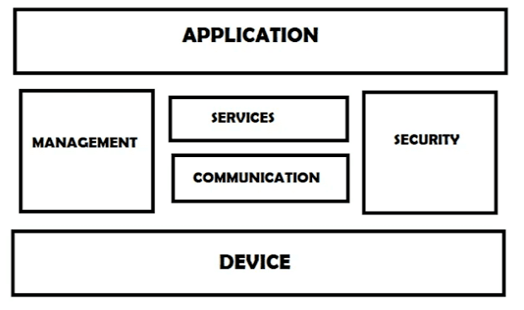
LOGICAL DESIGN OF IOT
IoT Functional Blocks: Provide the system the capabilities for identification, sensing, actuation, communication and management. The IoT system consists of different functional blocks which provide the system capabilities. These blocks includes:
Device: - This block deal with IoT device which provide sensing, monitoring and control functions.
Communication: - This block deals with IoT communication protocol.
Services: - This block deals with various types of IoT services such as device monitoring, device control services and device discovery.
Management: - This block used to monitor the
complete IoT system.
Security:- It provides the security by providing the
functions such as a authentication, authorization and
data security.
Application:-IoT provides an user interfaces to
monitor various IoT system where user can view and
analyze the processing data.

Slide 25
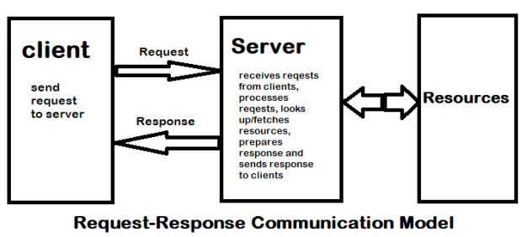
2) IoT Communication Models: There are multiple kinds of models available in an Internet of Things system that is used for communicating between the system and server, such as:
Request-Response 2) Publish-Subscribe
Request-Response Model: This model follows a client
server architecture. The client, when required, requests the
information from the server. This request is usually in the
encoded format.
In Request-Response communication model client sends a request to the server and the server responds to the request. When the server receives the request it decides how to respond, fetches the data retrieves resources, and prepares the response, and sends it to the client.

Slide 26
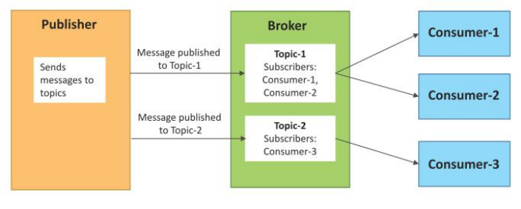
Publisher-Subscriber Model: This model comprises three entities: Publishers, Brokers, and Consumers.
Publishers are the source of data. It sends the data to the topic which are managed by the broker. They are not aware of consumers.
Consumers subscribe to the topics which are managed by the broker.
Hence, Brokers responsibility is to accept data from publishers and send it to the appropriate consumers. The broker only has the information regarding the consumer to which a particular topic belongs to which the publisher is unaware of.

